Slide 1
Warmer Welcome

Slide 2
Why we’re transforming volunteering

Slide 3
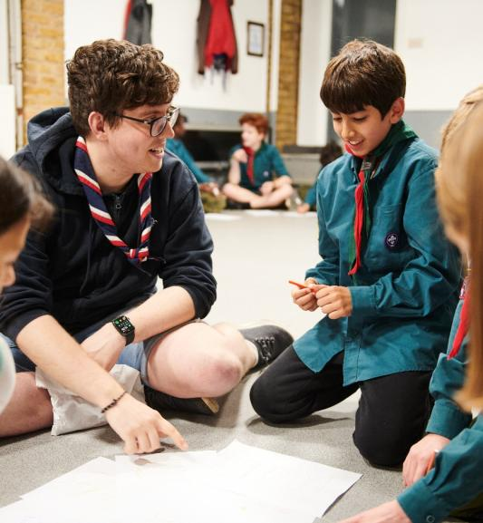
Why we’re transforming volunteering
Our Skills for Life strategy
To provide more young people, and the ones we already have, with skills for life, we need more volunteers
Every volunteer deserves to feel valued during their time with Scouts
The world is changing, and volunteers want more flexibility in the time they give
Ultimately…..

Slide 4








We want to make volunteering with Scouts easier and more fun…
…so that we can attract more volunteers and our current volunteers want to stay

Slide 5



Making volunteering easier and more fun is how we reach our North star...
More young people gaining skills for life
Consistently and safely
deliver a great programme
Recruit more volunteers
and retain current ones

Slide 6
What is changing?

Slide 7
Listening to our volunteers, young people and the public we’ve identified three key areas for change:
Providing a warmer welcome for everyone
Delivering a more engaging learning experience
Simplifying how we volunteer together
All of which will be supported by easy-to-use digital tools

Slide 8

Supporting Digital Tools
Scouts.org.uk Website
Easy to use and mobile-friendly
Single Sign On
Fewer steps and less administration
Specialist functionality
Digital first, but not digital only
Continuous improvement over time
Welcome Tool
Membership Tool
Learning Tool
Improved attraction
More transparency for new volunteers
Improved enquiry management
Reduced administration
Increased self-service
Easier and improved management of teams, permits, awards and more
More accessible learning
More engaging and enjoyable learning
Easier reporting and management of learning

Slide 9
Warmer Welcome
Welcome journey overview
Why we are changing
Welcome conversation resources

Slide 10
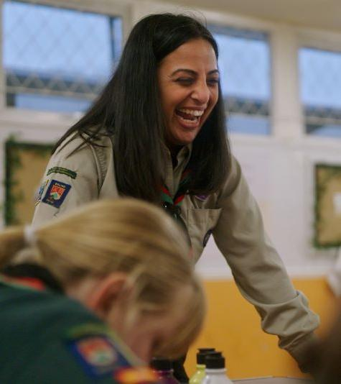
What did we learn from our research?
Joining us can feel daunting for new volunteers
New volunteers feel like our appointment panels are more like a job interview
The appointments process is time consuming and relies on inefficient tools and processes
We want more volunteers locally but need the support to make it happen
We’re often reliant on our existing networks to get new volunteers - parents, carers, friends, ex-members and current volunteers…
Notes:
Reference research with existing volunteers, Scouts staff and those outside of Scouting

Slide 11
Welcome Journey – What's Changing
A new feature in the membership system to assist in attracting new volunteers and to make it easier for existing volunteers to identify other opportunities
A simple, consistent joining journey no matter where a new volunteer joins:
  A more consistent, welcoming and easy way to complete the joining process, as a new volunteer and managed in the membership system
    Reducing the administrative burden on our volunteers by automating references, internal checks of our systems and declarations (these were not automated on Compass)
    Removing the Commissioner approval step and pre-provisional appointments status to simplify the joining process
    Replacing meetings with an appointments panel at each change of role by a single 'Welcome Conversation' when a volunteer first joins Scouts
    Growing Roots learning designed to provide volunteers with the information to do the basics for their role
    Removal of Appointment Advisory Committees
    Ensuring the new volunteer has the information necessary to feel supported through their induction with supporting resources and buddying opportunities
Notes:
A reminder of the current process and how it's changing (2 mins)
why we want to move from one process to another, why things aren't adding value currently. System at the moment burden on volunteers
A more consistent, welcoming and easy way to complete the process
It’ll be easier to see where a new volunteer is in their joining journey, as their progress will be tracked on their membership record.
Processes will be automated where possible to make an easier and speedier joining experience too, meaning less admin.
Removing Commissioner approval step and pre-provisional appointments to simplify the appointment process
The joining process will be less confusing with simpler steps to follow.
Lead Volunteers will no longer have to manually approve new volunteers, however they’ll have more visibility throughout their journey and clearly be able to see what's going on.
A welcome conversation instead of an appointments panel
Lots of people said they’d prefer a different way to welcome new volunteers, instead of an appointments panel.
We’re changing to a much more personal and welcoming experience for the new volunteer. This’ll give them the warmest welcome into their new volunteering journey
Continue introducing volunteer culture- to give an idea on approaching these difficult conversations with appointments panel members.

Slide 12

The Welcome Journey
Notes:
Alison
Introduce the welcome journey steps

Slide 13
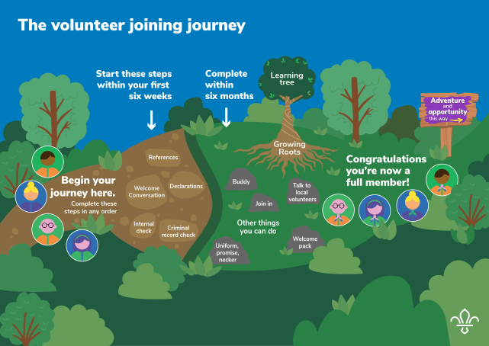
Steps to becoming a member
Notes:
Let's zoom out and look at the whole journey a new volunteer takes to become a full member -
I'd like to introduce you to Shivani. She is someone who has decided to volunteer with Scouts. She has never been a member and has no connection to Scouts, but is actively seeking a new volunteering opportunity.
Shivani will have previously gone through a few stages with us before this point, to decide if Scouts is right for her.
She will have expressed an interest, either online by talking to an existing volunteer.
Once she has been matched to a role and understands what's involved she can update her personal information in her profile on Scouts.org.uk, which could have been set up by her or the recruiting volunteer. From this point onwards Shivani and her local team leader will be able to follow her progress in the system.
When she logs in, she will be able to complete the steps in the yellow box in any order but they must be initiated within the first 6 weeks.
She can go through the disclosure process on her phone now and it will be quicker and easier to do.
The references process is improved- as soon as she submits the referee details the system will contact them directly. Her referees can complete the request then and there for an instant response.
Once she's had the welcome conversation and the result is recorded that part is complete.
She will also have to sign the declarations which will give her permission to access further information if need as part of her role. If it's relevant to her role she may need to complete a trustee eligibility check too, but not all new volunteers will have to do this.
The internal check on HQ records will automatically happen whilst the other checks are progressing, but Shivani and her team leader will be able to see when that's complete and if anything is highlighted from it.
Shivani is responsible for completing her growing roots learning and she'll have 6 months to complete this.
Whilst completing these checks she will also be able to begin her local induction and get volunteering. Further information will be coming in a future call about all the elements the Scouts Volunteering induction includes.
In other scenarios, so
If she was changing or adding a role as an existing volunteer, she would have to re-complete declarations and the internal check, but won't complete a new welcome conversation.
If Shivani was a young leader is transitioning into an adult role, she would have to complete all checks and the welcome conversation.

Slide 14



Resources to support Welcome Journey
Notes:
Heather
We have developed a set of resources to support welcoming new adults. These have been created as a result of feedback and listening to lots of different stakeholders, and subject matter experts. Also as a result of previous collaboration work with Girlguiding in the discovery and research phases.

Slide 15
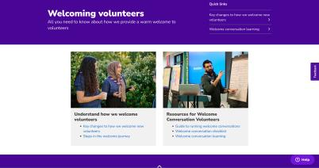
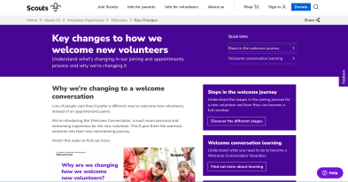
Welcome Resources
  These webpages will become part of the Volunteer Experience section of the website
  They are a collection of different resources for members to support the journey of a new volunteer. They include:
    Checklists
    Video to explain why we're changing from appointments panels to welcome conversations
    Learning
  Transparency on the steps involved in becoming a member of Scouts
Notes:
Heather
The resources are all hosted on scouts.org.uk, and will be within the Volunteer Experience pages once they go live to all.
You'll find a central page which will link to all the welcome resources needed to support the joining journey of a new member. We'll build on these over time and it will become a hub for all welcome resources
Here you'll find an explanation of why we're changing the process, checklists and supporting guidance on running the welcome conversation and the learning needed to be completed by a welcome conversation volunteer.
You should have all received these in the email before the call. If you have feedback on the page layout or content please do get in touch through the TL inbox, or fill in the pop up poll directly on the pages.

Slide 16
Why have a welcome conversation?
How might this work in a Group/District/County?
  Great first impression
  New volunteers feel welcome, valued and supported
  Helps them to be prepared at the start of their journey
  Is Scouts right for them?
  We need to make sure they understand and commit to our values and Promise, and how we keep young people safe
  Chance for them to ask questions
  Currently:
  Volunteers can hold their only role as a member of the AAC
  Changes:
  Must be an existing full member
  Must have completed the welcome conversation learning and/or received the Welcome Conversation Volunteer accreditation
  Having sufficient Welcome Conversation Volunteers is the responsibility of the Volunteering Development Team
Notes:
So, why do we still need to have a welcome conversation.
We want to give a great first impression to new volunteers. We want them to feel welcomed, valued and supported in their first few weeks of joining.
The welcome conversation will help them to feel part of the team and prepared for their volunteering. It will help us work out if they're right for Scouts but most importantly if Scouts is right for them.
At Scouts, we always put young people first and we're committed to following the NSPCC guidelines for safer recruitment. The welcome conversation is an opportunity to make sure new volunteers are clear on our expectations of them. We need to make sure they understand and commit to our values, and how we keep young people safe.
We have the opportunity to connect with new volunteers at the start of their journey. It’s a great opportunity for them to ask questions openly to help them understand their tasks and responsibilities.
How does this work compared to our current process?
The appointments panel is going to go, and new volunteers will have a welcome conversation instead.
Currently you can be an appointments panel member as part of the appointments advisory committee. Being a member of the appointments panel could be your only role at Scouts. This currently sits as a sub-committee of the trustee board. Moving forwards into the new structure welcome conversations will be carried out by two people- the local team leader or lead volunteer and another 'independent' volunteer who could be part of another group but will have a similar role to the one being recruited.
We want Districts, Counties and Regions to have lots of members who could hold the welcome conversation and support recruitment in their area. They will not be able to run a welcome conversation for anyone in their group and they will have to do the learning to receive the Welcome Conversation accreditation.
The accreditation gives them permission to do the task and it'll be linked to the volunteering development team, so they will know who in their local area can deliver welcome conversations. When a team leader needs a welcome conversation for a new adult they should approach the volunteering development team who will be able to suggest some independent volunteers who have no existing connection to the group or new volunteer.

Slide 17
Welcome Conversations – Who should carry them out?
What you’ll need to do
Two volunteers carry out the Welcome Conversation together:
The Lead Volunteer or Team Leader who is responsible for the new volunteer's recruitment. They must have completed the Welcome Conversation Learning and be someone that the new volunteer has not met previously.
A second volunteer, who is not part of the same Group or Team, who has a Welcome Conversation Volunteer accreditation
  To have a Welcome Conversation Volunteer accreditation, you’ll need to be an active member of a Group, District or County Team, who's completed the necessary learning, and agreed with the Volunteering Development Team Leader that you can take on these responsibilities
Can current members of the Appointment Advisory Committee carry out Welcome Conversations?
Yes, anyone who meets the above criteria can deliver welcome conversations as part of their role. Delivering welcome conversations cannot be a role in itself.
Do people carrying out Welcome Conversations need to complete any learning?
Yes. This consists of 3 videos which will include any necessary validation.
Notes:
As mentioned previously, welcome conversations cannot be carried out by volunteers from the same group.
It means that current members of the appointments advisory committee will have to gain the accreditation to deliver the conversation, and that those who do deliver the conversation should have a similar role to that of the new volunteer, for example a beaver team member can deliver the conversation for a fellow new Beaver or Squirrels team member from another group- they should be someone who they connect with around the experience within that section.
they need to a) be a full member (in a different Group), b) do the welcome conversation learning and c) receive a Welcome Conversation Volunteer accreditation. They co-lead the welcome conversation with the team leader or Lead Volunteer - who'll be able to carry out welcome conversations as default as part of their role and will also need to undertake the learning.
Alison is now going to take us through running Shivani's welcome conversation

Slide 18



What does this mean in practice?
What you’ll need to do
Shivani has volunteered to become a member of the Beavers team at her local group. She has provided all the additional personal information on the Membership System. One of the next steps is to have her Welcome Conversation.
Zara, the Group Lead Volunteer, has already explained about the role and reaches out to the Volunteering Development Team to initiate a Welcome Conversation. They suggest Keenan, a Beavers Section Team Leader who has a Welcome Conversation accreditation, from the neighbouring Group.
Zara and Keenan arrange to meet and carry out a 30-minute Welcome Conversation before Beavers at the group meeting place. Both Zara and Keenan agree on the outcome. Zara records the outcome in the membership system, and it sends a notification to Keenan.
Shivani - Beaver Section Member
Zara - Group Lead Volunteer
Keenan - Beaver Section Team Leader

Slide 19
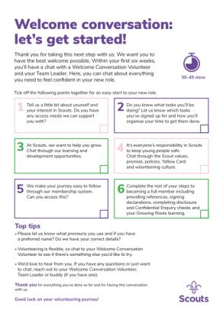
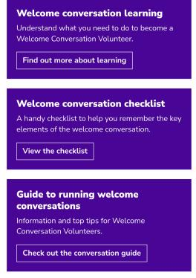
Welcome conversations
Website includes information on:
Learning required to be able to carry out Welcome Conversations
A checklist to act as a reminder of what needs to be covered when carrying out Welcome Conversations
More details around running Welcome Conversations
Notes:
We've created webpages to explain everything about running a welcome conversation. They include a comprehensive guide on how to run a welcome conversation, a checklist that can be downloaded and used when carrying out the conversation, and everything you need to know about learning for those volunteers who will be delivering welcome conversations. For volunteers who are delivering the welcome conversation they need to be an active Scouts member with an existing role in the new structure and have completed the Welcome Conversation learning
These have all been designed based on feedback and iterations through speaking to volunteers, as well as people external to Scouts and running workshops with groups of subject matter experts including inclusion specialists.
Checklist- talk through how feedback has led to this resource and how it has been created to aid support in the conversation for both the new volunteer and the welcome conversation volunteer

Slide 20
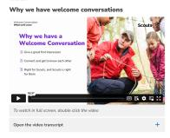
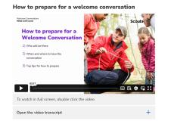
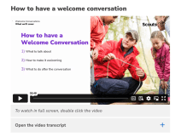
Welcome conversation learning videos
To carry out Welcome Conversations, volunteers will need to have a 'Welcome Conversation Volunteer' accreditation
There will be a series of videos to watch to support understanding of carrying out the welcome conversation
These have previously been shared with Early Adopter Transformation Leads to help iterate to the current point
There will be a new version before November based on feedback we have received
Notes:
There is a suite of videos which will be included on the new learning system, as well as on these webpages. These are the videos which any volunteer who is involved in the delivery of the welcome conversation will need to watch to be able to deliver the conversation locally.
They can start watching these videos prior to go-live.....
There will be a newer version of these videos ready for when this launches to the 90%
Need to keep a local record pre- day 1 of the people who have watched these before go live so they can be added to the system as soon as its ready. We have a set of 3 videos currently which will make up the learning needed to gain the accreditation. (These videos will also be enhanced to a new version compared to the ones on the current webpages).Team leaders and lead volunteers will also have to complete these videos for delivering welcome conversations in their teams or areas. These videos will be on the learning system for day 1.
Previously shared with EA TL's and asked for feedback
Now sharing wider and added Hotjar questions added on all welcome webpages
In development, feedback by....

Slide 21



Open Forum

Slide 22
Next Steps
For everyone:
Ensure your email address and other personal data is up to date on Compass
Ensure all training is validated on Compass
Know what team/role you’ll transition into
For local leadership:
Transition your Executive Committee to a Trustee Board
Keep your patch informed of what's happening and what they need to do
Build your new teams
If you haven’t heard about the volunteer experience changes locally, or have questions contact your County Transformation Lead, DC or CC

