Slide 1
Teams & Tasks Workshop
Notes:
Kester

Slide 2
Why we’re transforming

Slide 3

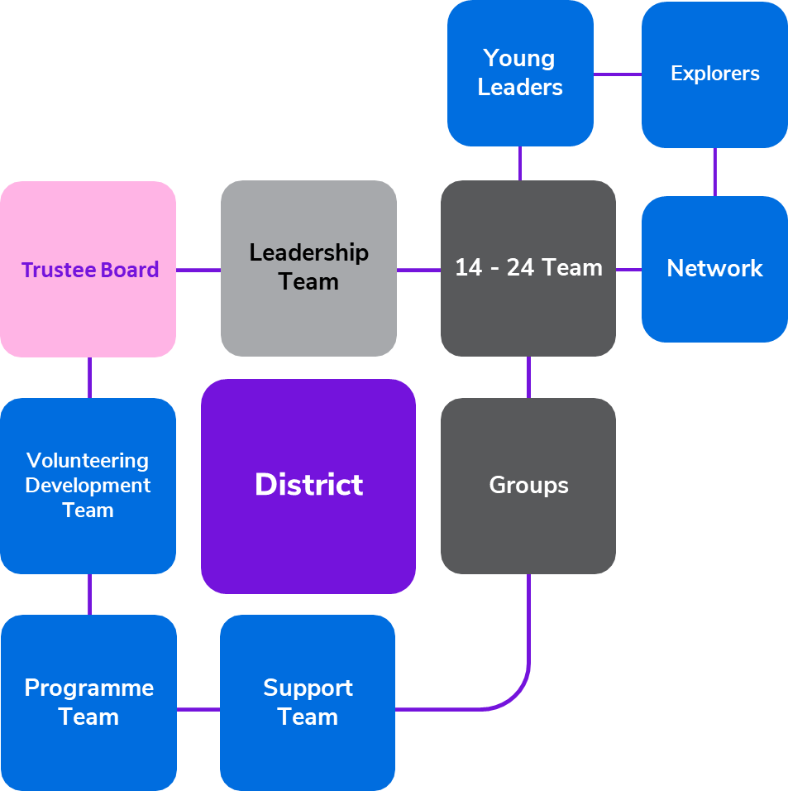
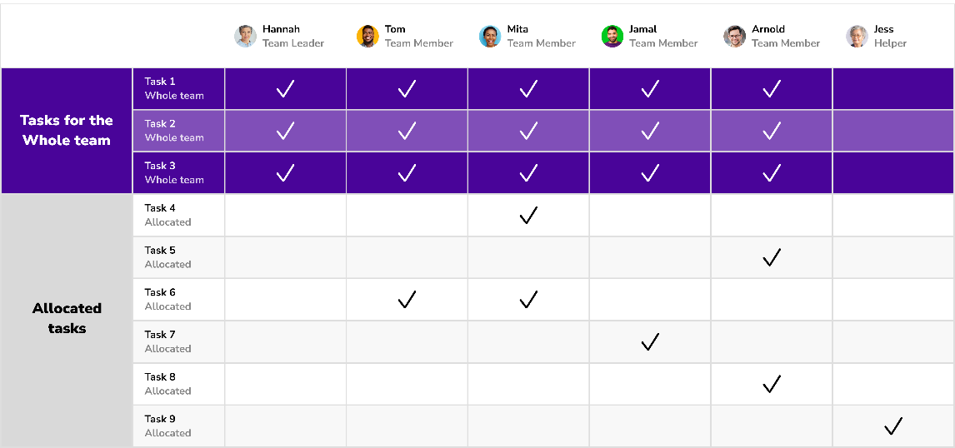
Our new principles
We volunteer flexibly as part of a team with a shared purpose.
Our teams and titles are easier to understand and more appealing to new volunteers.
Teams agree how to share tasks between them and this can change over time.

Slide 4
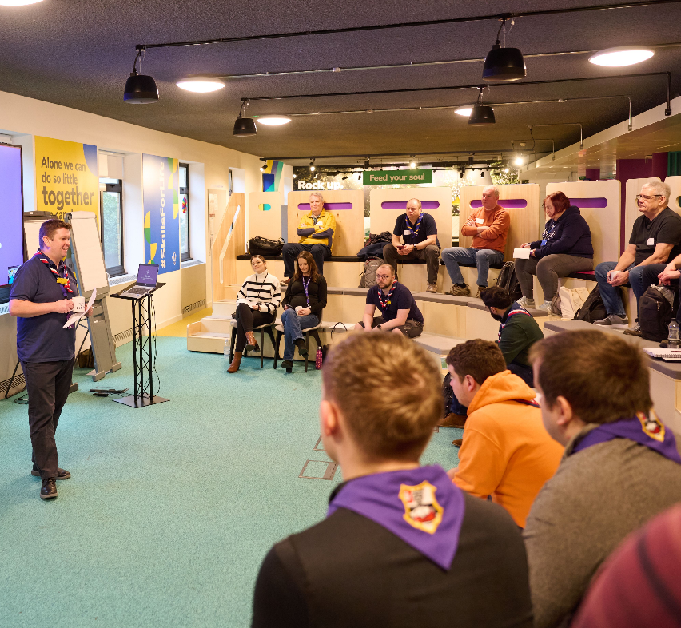
Our Volunteering Culture
We want Our Volunteering Culture to be something we're all proud of
As volunteers in Scouts, we’re proud to help young people step up, speak up, dream big and gain the skills they need for life
By working together, and living our values of integrity, respect, care, belief and cooperation, our aim is to have a positive, safe and rewarding experience as volunteers for a movement we truly believe in
It’s not something ‘extra’ to do. It’s at the heart of everything we do and it’s there to help us all

Slide 5

Notes:
Hamish

Slide 6
Simplifying how we volunteer together

Slide 7
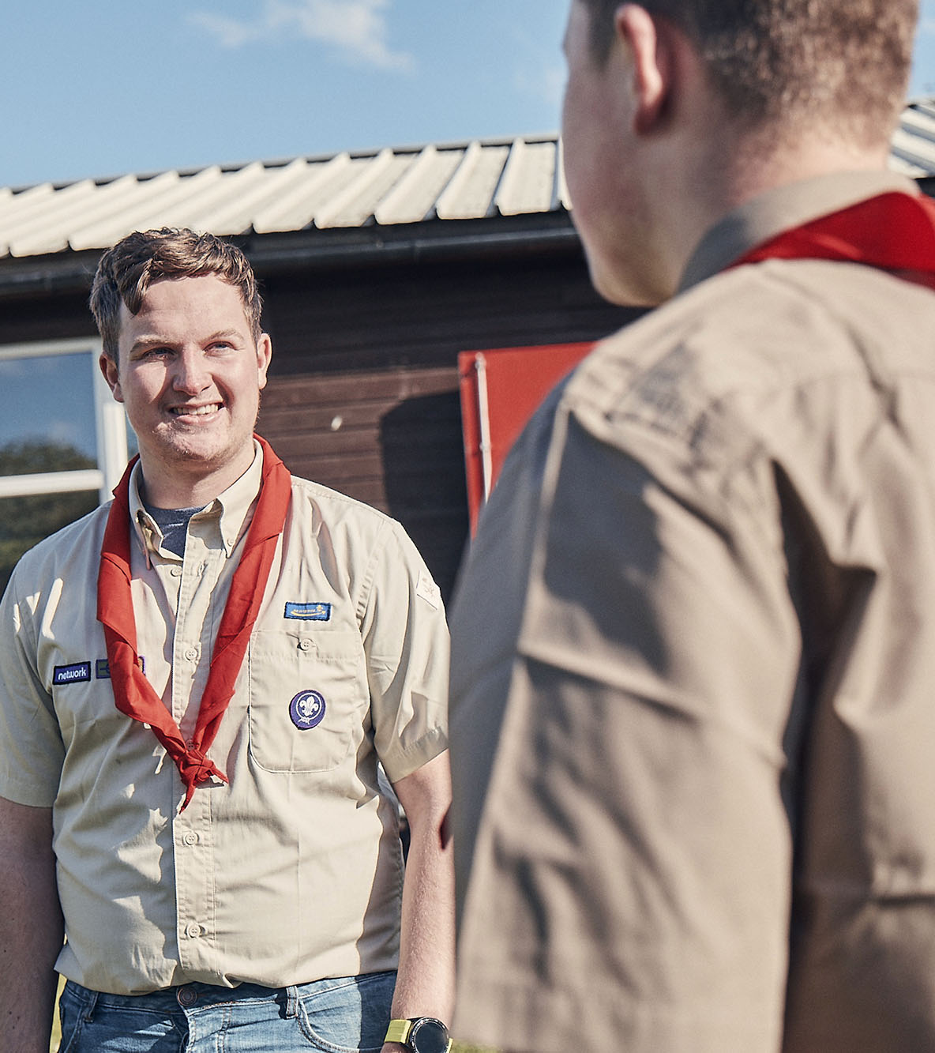
Team Descriptions
Every team has:
  A purpose to explain what the team is for and how it plays a part towards our vision
  Who’s in the team to be clear about who is involved in the team and what they’re called
  Tasks for the whole team which everyone in the team will be involved with
  Allocated tasks which can be shared out between members of the team

Slide 8
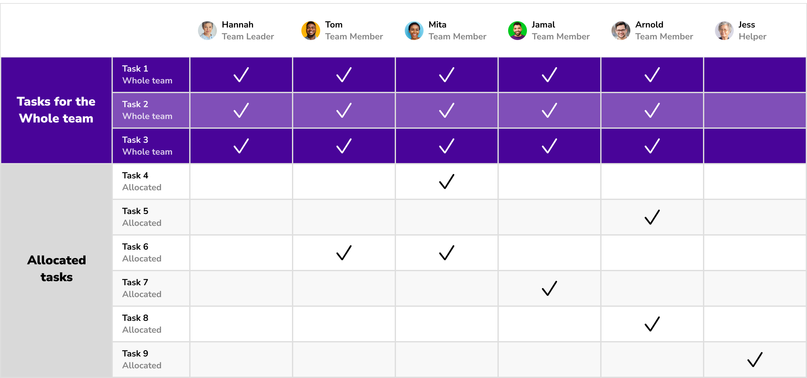
How a team shares tasks

Slide 9
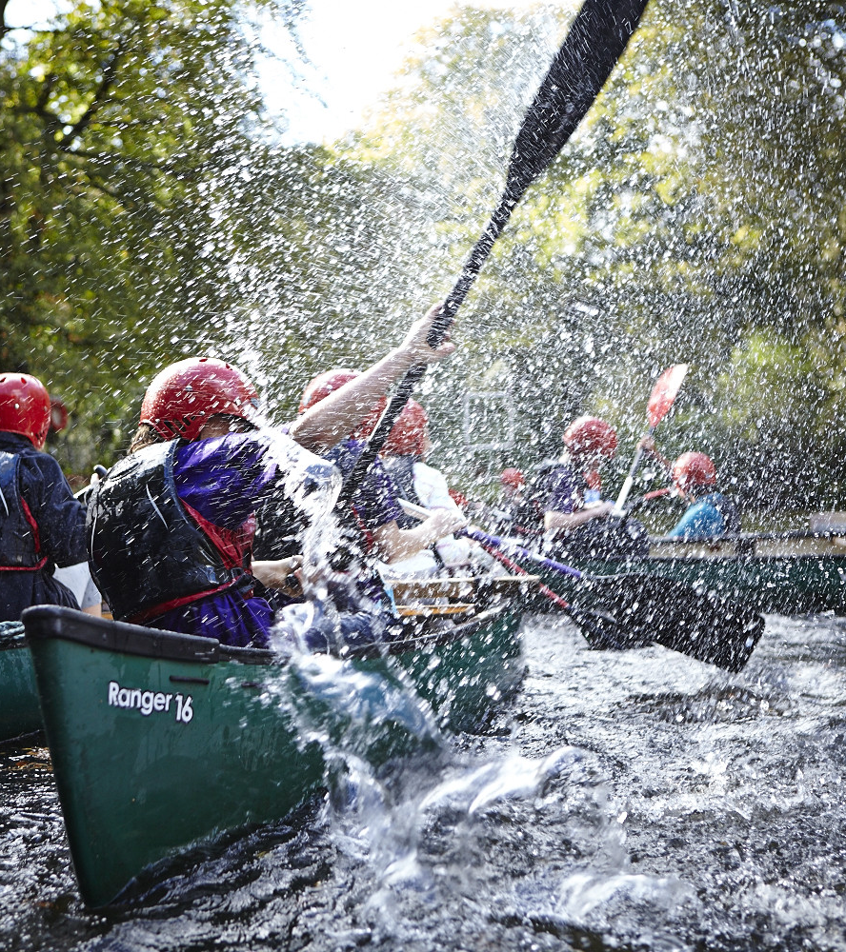
Role Title Changes
To support these changes, role titles will be changing alongside this
This is being done to help:
Make our roles clearer
Make it easier to share tasks as a team
Support recruitment of new volunteers
Driven by research informing us:
New volunteers find it hard to understand the expectations of different roles which can put them off joining
Current volunteers have said they find it hard to understand the many different role titles we currently have
We have a small number of people/roles with lots of responsibility and stress placed on them

Slide 10
Role Title Changes
Current | Becomes
Area Commissioner | Area Lead Volunteer
District Commissioner | District Lead Volunteer
Group Scout Leader | Group Lead Volunteer
Youth Commissioner | Youth Lead
Executive Committee Member, Secretary | Trustee
District Explorer Scout Administrator | 14-24 Team Member
Section Leader | Section Team Leader
Assistant Section Leader Section Assistant | Section Team Member
All Assistant / Deputy Roles | Team Member of relevant team (usually Leadership)
Occasional Helper | Non-Member (Needs Disclosure)
Only Group & District section roles will automatically map across to the Team Leader role. All other District & Area Team Leader roles should be agreed locally and then be added to the system.
A full list is available on the Scout Website

Slide 11
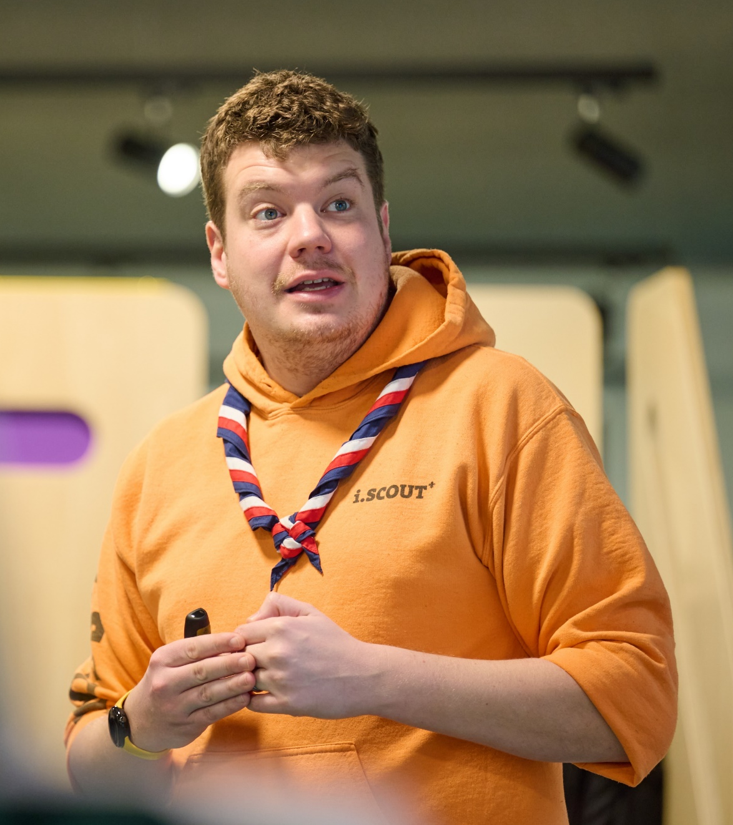
Role Titles
These changes are about how we organise ourselves and our teams, but you’re still…
A Scout Leader, Beaver Leader, Skip, Owl, Badger, Akela, Raksha…
That isn’t changing!

Slide 12
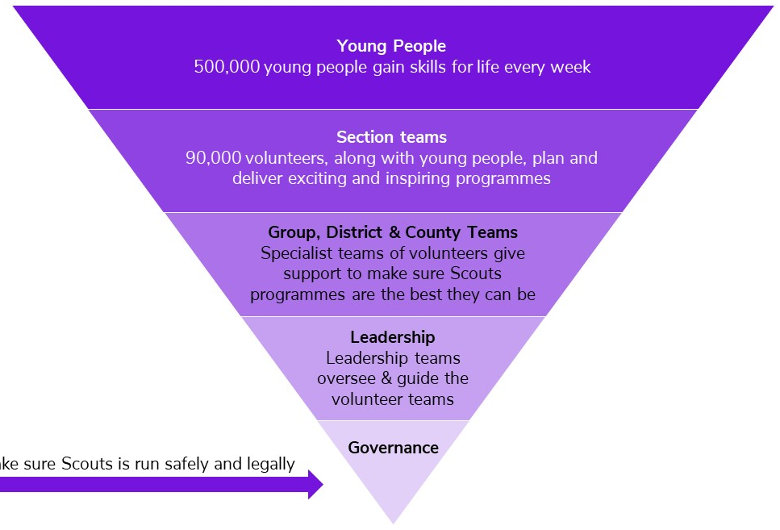
Volunteers other than members of Section Teams
Provide leadership, direction, management
or
Provide support to:
  Programme
  Volunteers
  Community engagement
  Growth - new provision
  Processes, for example
    Premises management
    Fundraising
    Equipment management
    Digital tools (email, web, etc.)
  Incident management
    Planning for the management of potential issues
    (including complaints, SARs, data breaches, safeguarding issues, safety issues, etc.)
Notes:
Hamish

Slide 13
Group Teams
Group Leadership Team
Leadership/direction/management
Programme support
Volunteering Development
Community engagement
New provision
Process support
Team Leader(s)
Sections
Team Member
Team Member
Section Team
Group
The Group Leadership Team and the Trustee Board can have sub-teams where appropriate.
Section teams may not have sub-teams.
Young Leader
Team Member
Young Leader
Group Leadership Team
Trustee Board
Notes:
Hamish

Slide 14
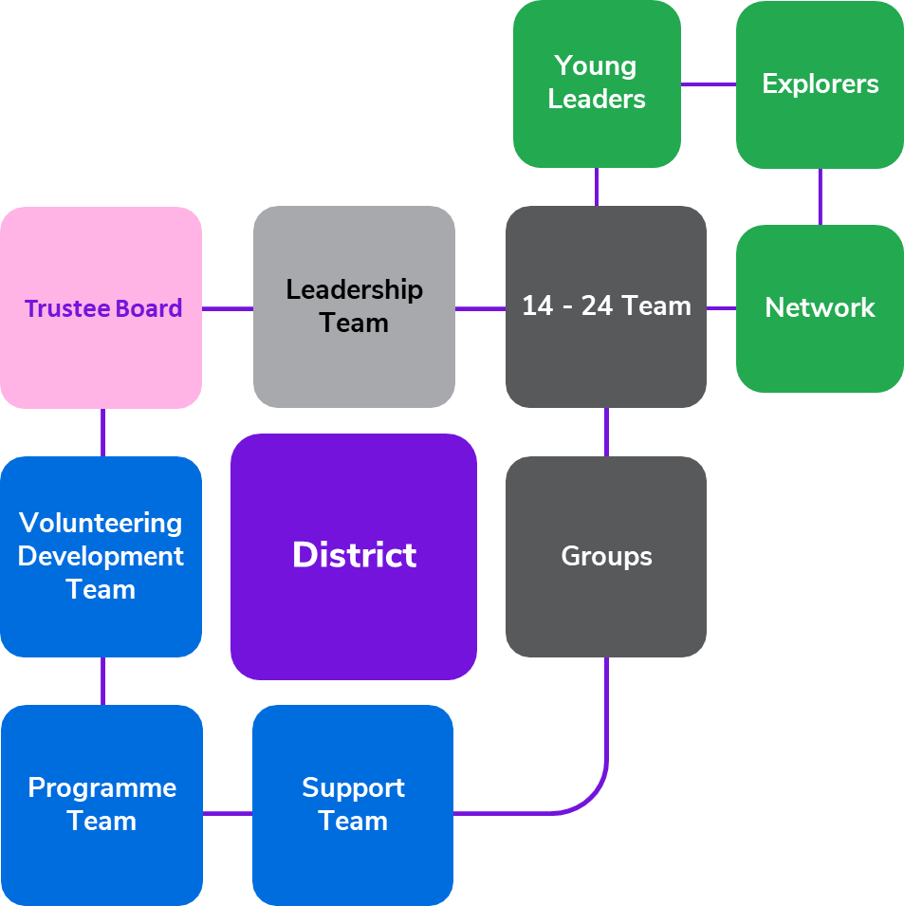
District Teams
District Leadership team
Vision/direction/management
Ensuring implementation of the District’s element of the Area Plan
Incident management plans for District and Group incidents
District 14-24 Team
Similar to the Group Leadership Team for Explorers (including Young Leaders) and Network
District Programme Team
Programme support for all sections
District Volunteering Development Team
Volunteering Development for members of the District’s Teams
Volunteering Development support for Groups’ teams
District Support team
Community engagement
New provision
Process support for the District & its Groups
Each of these teams (except Section Teams)
can have sub-teams where appropriate.
Notes:
Hamish

Slide 15
Area Teams
Area Leadership team
Vision/direction/management
Develop & implement Area Plan
Maintain incident management plans for ‘Area’ incidents
Area Programme Team
Supporting District Programme Teams
Area Volunteering Development Team
Volunteering Development for members of the Area’s Teams
Supporting District Volunteering Development Teams
Support team
Area-wide view for
  Community engagement
  New provision
  Process support for the Area and, where appropriate, its Districts and Groups
Trustee Board
Leadership Team
Area
Districts
Volunteering Development Team
Programme Team
Support Team
Each of these teams can have sub-teams, where appropriate.
Notes:
Hamish

Slide 16
Accreditations

Slide 17
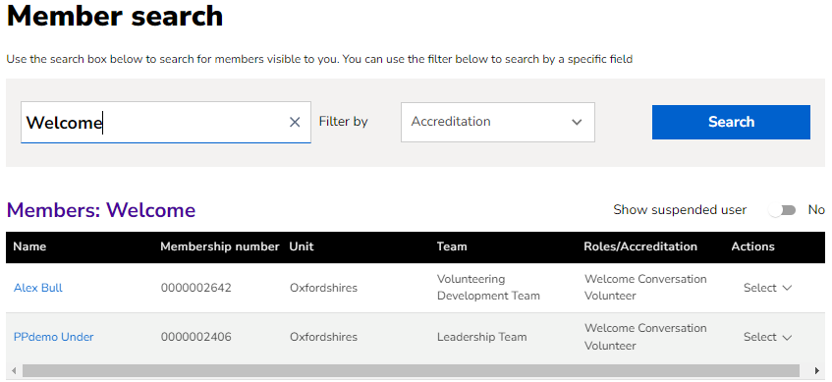
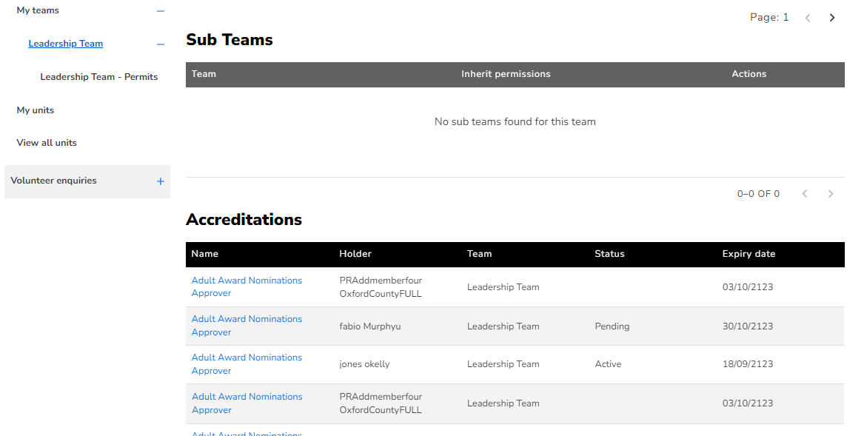
  Accreditations
Why are accreditations introduced?
What problem are we solving?
Rather than allocating tasks to a team, we sometimes need to allocate a task to one or more specific people
A key benefit of this is that some bite-sized tasks can be shared with people who have their primary role in another team, rather than them taking on the full responsibility of an additional team
They also benefit a team so that the team can focus on its core purpose
An important benefit is that some roles become more attractive and achievable, without distracting too much from the volunteer’s primary role
It also enables Lead Volunteers to share some responsibilities and draw on volunteers' expertise and experience in key areas, for example safeguarding.

Slide 18
  The accreditations
Affiliated to County Leadership Team
  Awards Nominations Supporter
  Data Lead
  Nights Away Approver
  Permit Approver
  Resolutions Lead
  Safety Adviser
  Safety Lead
  Safeguarding Adviser
  Suspension Lead
  Visits Abroad Approver
  Visits Abroad Recommender
  Volunteer Safeguarding Lead
Affiliated to County Programme Team
  Adventurous Activity Assessors
  King’s Scout Award Parcel Recipient
  Manager of the Activity Permit Scheme
  Nights Away Assessor
  Visits Abroad Recommender
Affiliated to County Volunteering Development Team
  Awards Parcel Recipient
  Disclosure Support Volunteer
  First Response Trainer
  Learning Assessor
  Recruiter
  Trainer
  Welcome Conversation Volunteer
Affiliated to District Leadership Team
  Awards Nominations Supporter
  Data Lead
  Nights Away Approver
  Permit Approver
  Resolutions Lead
  Safety Lead
  Suspension Lead
  Volunteer Safeguarding Lead
Affiliated to District Programme Team
  Nights Away Assessor
Affiliated to District Volunteering Development Team
  Awards Parcel Recipient
  Disclosure Support Volunteer
  First Response Trainer
  Learning Assessor
  Recruiter
  Trainer
  Welcome Conversation Volunteer
Affiliated to Group Leadership Team
  Nominated Person
  Recruiter
Affiliated to District 14-24 Team
  Nominated Person
  Recruiter
Notes:
Andrew

Slide 19
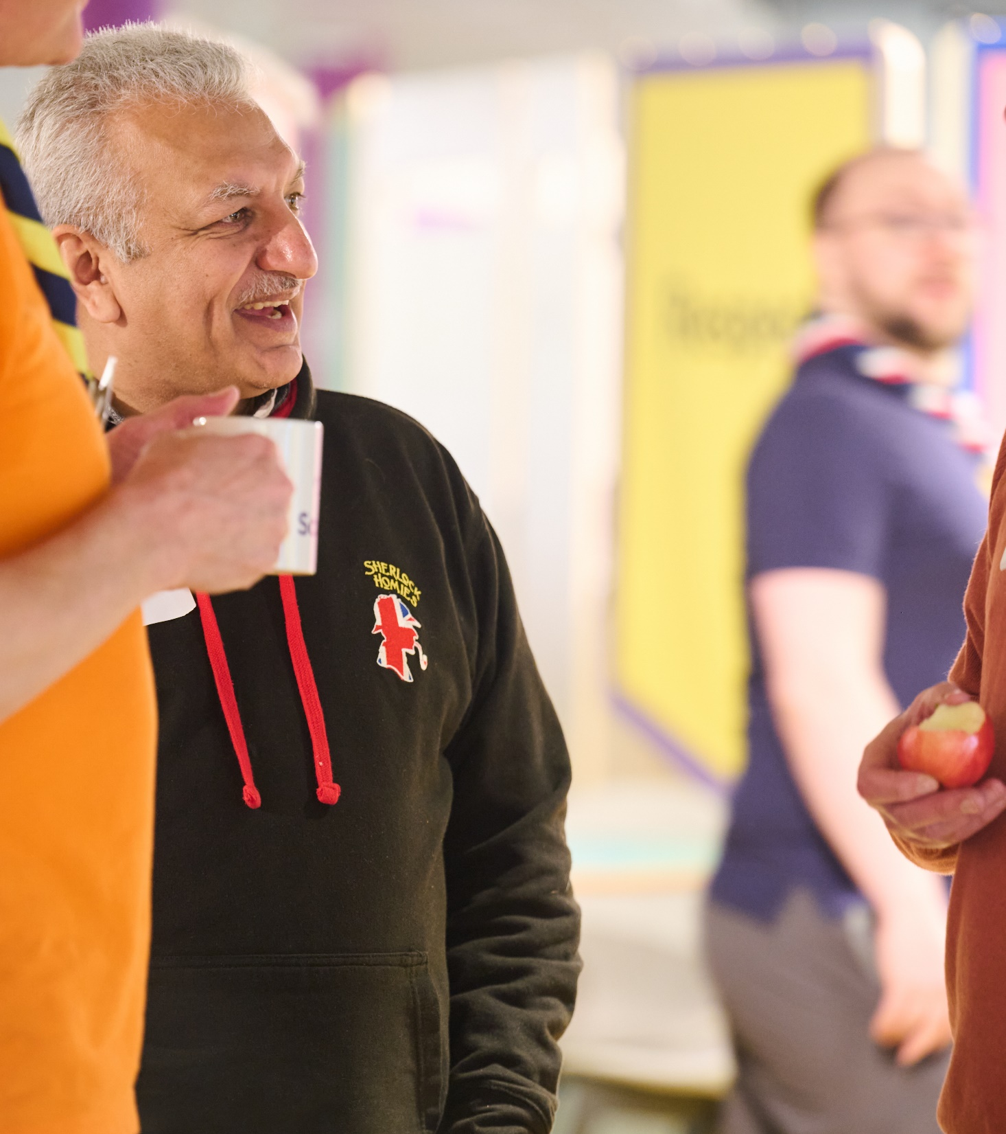
  Accreditations - core principles
Accreditations are a way of sharing tasks and responsibilities, where a volunteer needs to be given certain permissions to take these on
Available accreditations are listed in the Accreditations Table in POR; no others can exist
Accreditations are not ‘roles’ - they're permission to do a specific task
Accreditations can only be given to volunteers who are already full members
Accreditations are usually given by the Team Leader of that team or a Lead Volunteer

Slide 20
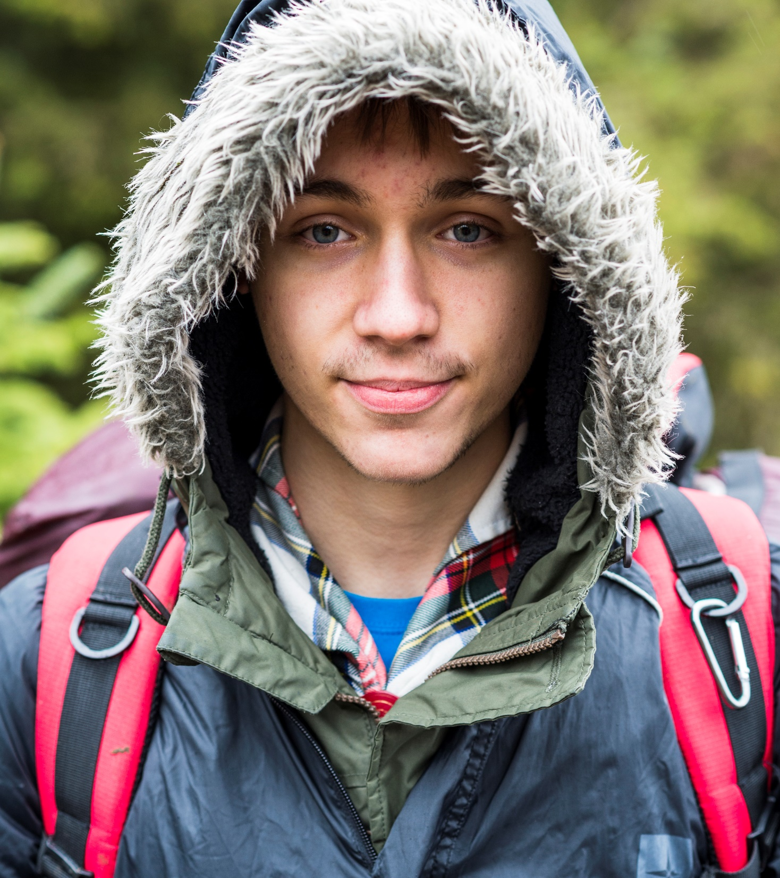
  Key facts about accreditations
  Accreditations will reflect:
For some topics, the need to have a person with particular (usually specialised) skills
In other cases, the sharing of responsibilities so that one individual (e.g. a Lead Volunteer) does not get overloaded
Or, the need for UKHQ to know who to contact to about a particular topic (for example who to send Awards to within a Area or District)
  Accreditations are not a team membership
  An accreditation does not create a membership of a specific team. However, the task is affiliated to a team.
  For example, a Cub Section Team Member who is an excellent kayaker could have an appropriate “Kayak Assessor” accreditation. They would be affiliated to, but not be a member of, the Area Programme Team.

Slide 21

  The Accreditations Table
Most accreditations have pre-requisite(s) that must be verified before the accreditation can be given
The accreditations table shows, for each accreditation:
  Accreditation title
  The team responsible for the accreditation (creating, where necessary, an informal network of affiliated people who have that accreditation)
  Who (role) can give or remove the accreditation
  About the person who can hold the accreditation
    whether they are in a role that undertakes regulated activity
    what learning must the person have already completed, and what other qualifications must already be held
    if an internal check is needed for the accreditation
  Maximum time that the accreditation can be held for before review
  If no accreditation is given, who do the related responsibilities and tasks sit with by default

Slide 22

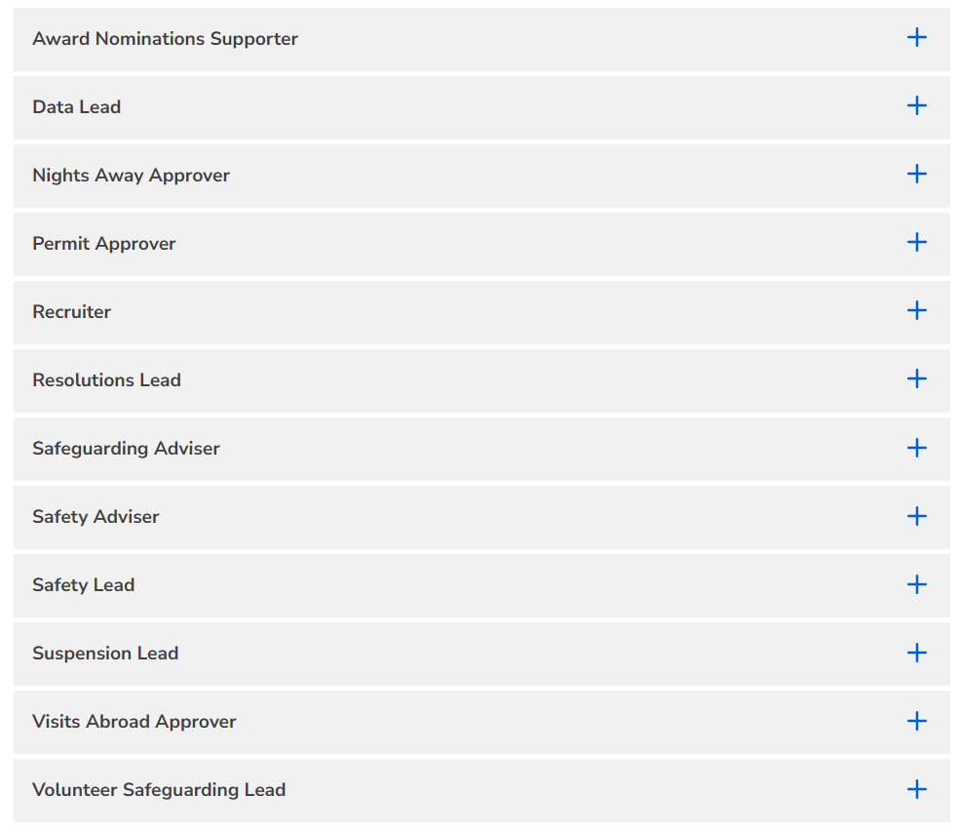
  Useful resources - accreditations
Accreditations | Scouts
Leadership Team Accreditations | Scouts
Programme Team Accreditations | Scouts
Volunteering Development Team Accreditations | Scouts
UKHQ Accreditations | Scouts

Slide 23



Questions

Slide 24
Break

Slide 25
Building your teams

Slide 26

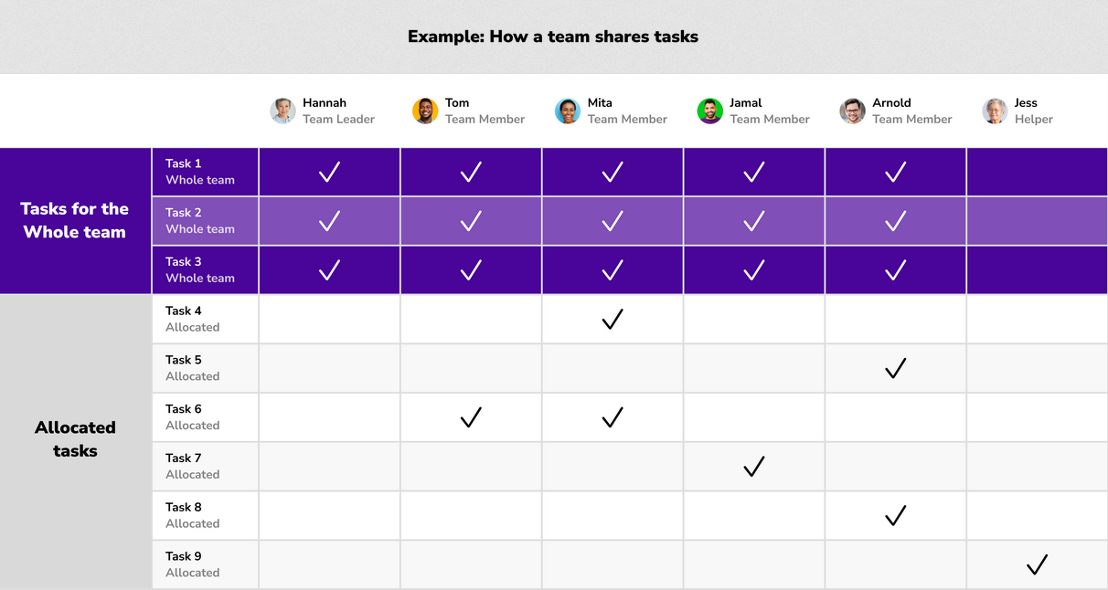
  Teams - core principles
Key action: Make sure that for each Area, District, Group and team...
Programme is at the core of everything
Each Lead Volunteer is clear that only the teams listed in the organisation diagrams & POR may exist. Teams (except Section Teams) may have sub-teams if appropriate to their operation.
Each team member understands the core principles of working in teams - see Volunteering Together and Our Volunteering Culture
Each team must meet their Team Description, but can organise themselves to achieve that, so that each team member is clear about their role in the team - see How volunteers work in teams

Slide 27
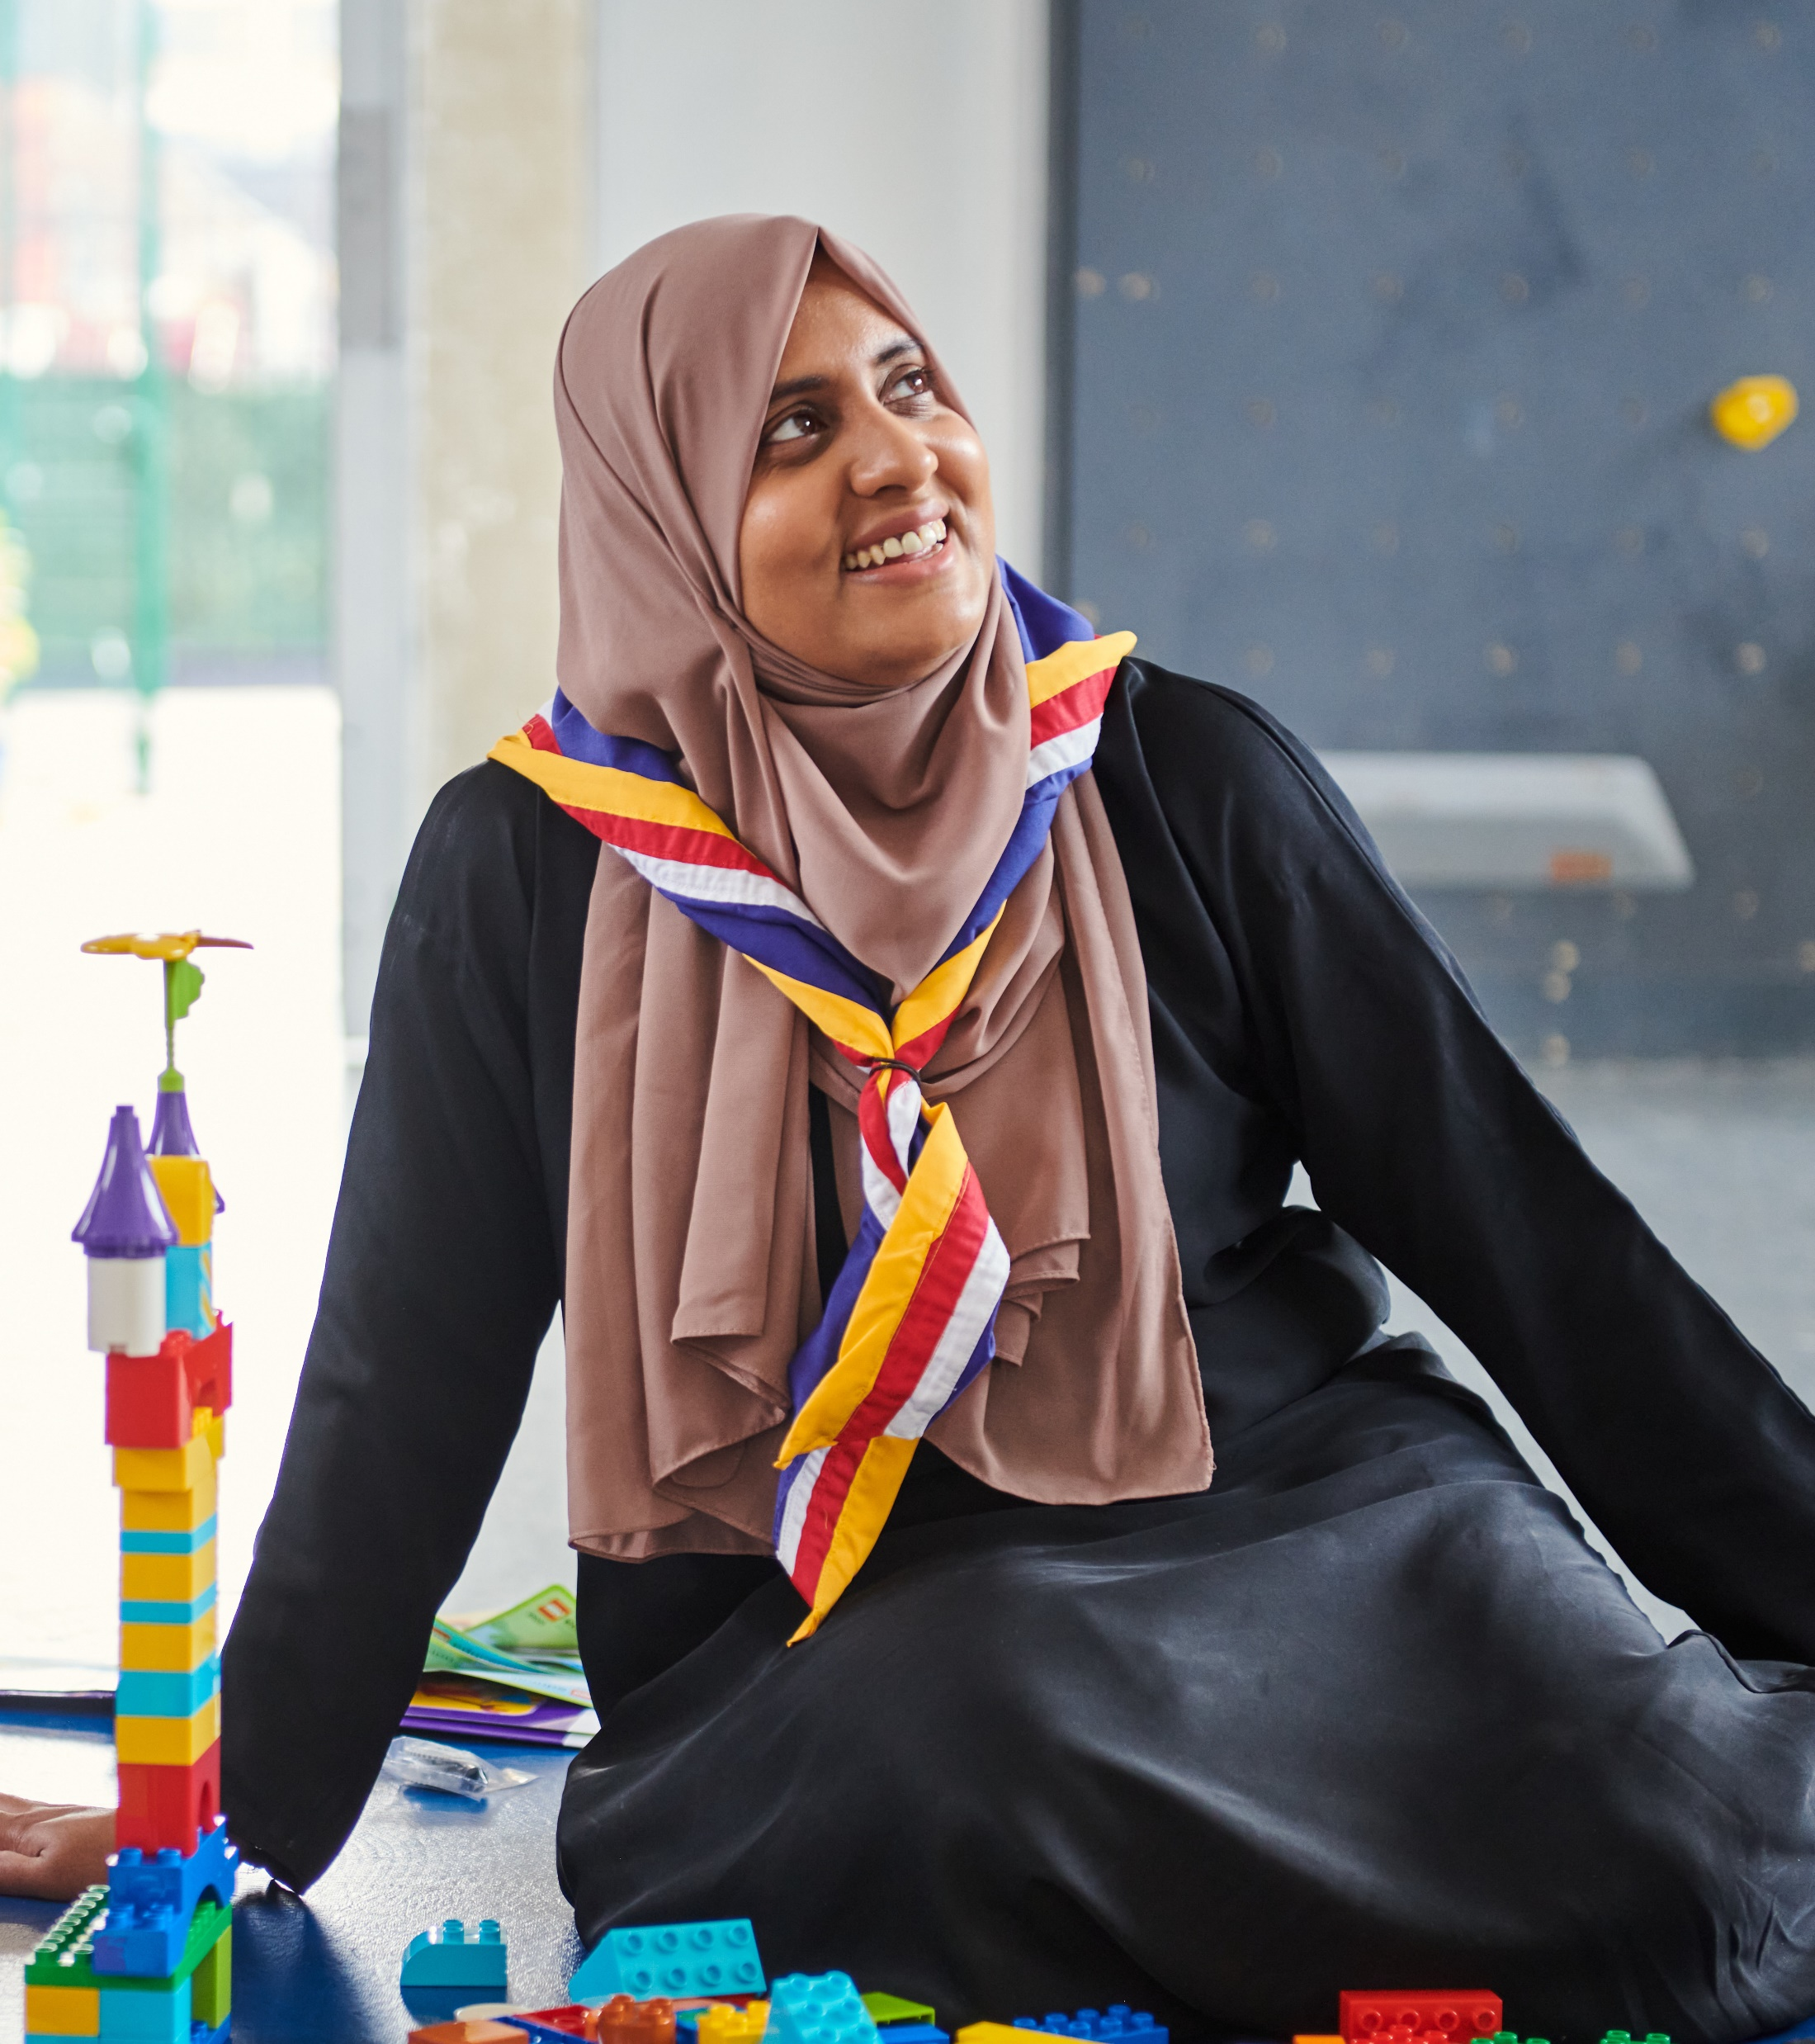
Principles
Use the team descriptions to shape your local structure and identify current volunteers who best fit these teams
Consider who will hold accreditations relating to the team (mostly Area and District teams, but may be given to volunteers in Groups)
Consider any teams that might benefit from being shared with another Area/District
Refine your team structure in conversation with your current volunteers

Slide 28
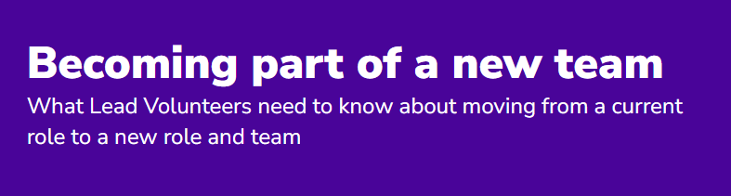
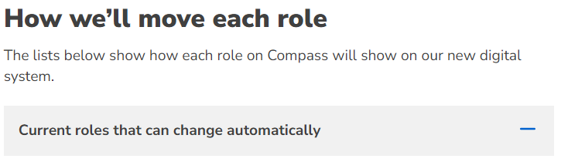
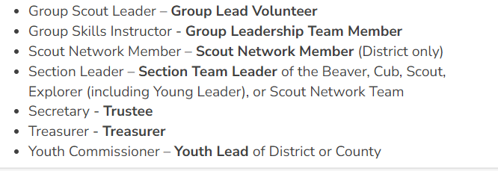
  Mapping current roles
85% of volunteer roles will map automatically; these are mostly in Groups, Sections and Trustee Boards along with some District roles
15% of volunteer roles will not map automatically; these are mostly District & Area roles
In all cases it's important to consider and discuss what is the best use of a volunteer's skills and preferences
It’s important that volunteers are aware of what their role and team will become
All roles which map and all which need a conversation are available on the Becoming part of a new team webpage

Slide 29
Inclusion
It’s important that teams are inclusive:
It’s embedded in Our Volunteering Culture
Inclusion must be built in, not a bolt on
It's fundamental to everyone's role and team
Notes:
We had a brilliant inclusion day for volunteers in November, and the feedback highlighted that want to bring inclusion to the forefront of our minds when setting up our new teams. So we'll have a look at where inclusion might fit in our new team structures.
Some core principles are:
It's embedded in Our Volunteering Culture. As part of our culture at Scouts we commit to Equity, Diversity and Inclusion in everything we do, making sure everybody has access to our activities and can thrive in Scouts. And as volunteers we want to promote a welcoming and inclusive environment where we treat everybody fairly and with respect, making sure our values are part of everything we say and do.
Inclusion should be on everyone's agenda. If it isn't specifically built in to what everyone does in every team, it can be forgotten about. We want to make sure it’s built in, and not bolt on.
And it's fundamental to everyone's role and team
We’re currently working together to build on the success and progress to date to embed EDI right across teams and how we volunteer together. As part of this, we're currently reviewing our team descriptions and making sure that we're explicit about how inclusion is embedded within our teams.

Slide 30

  Team leadership
  The team leader role (including Lead Volunteers & Chairs) is to:
    Create a positive team environment
    Help their team members to find what they need
    Attract and welcome new volunteers
    Reflect and review with the team
  Action: Ensure clear understanding and effective leadership of each team by:
  Making sure each team (Area, District and Group) has someone that leads the team
  Ensuring each team leader is clear about their role of facilitating the team so that it collectively achieves the purpose in its team description

Slide 31
Practical Ideas
Some examples of what you might consider while shaping your local team structure:
How could share teams & tasks between Districts/Areas
How using, or not using, sub-teams can help
How to identify Welcome Conversation volunteers
How to use volunteers whose current role doesn’t naturally fit into a team

Slide 32


Next Steps

Slide 33
Summary of next steps
Each Area, District, and Group should:
  Shape their local structure
  Consider who will have accreditations relating to each team
  Appoint Team Leaders and Team Members for each of the teams (and any sub-teams where relevant)
  Have discussions with all current team members
  Start to informally work in new team structures

